Slide 1


Intermediate Python
Data with Numpy & Pandas & Mathplotlib

Slide 2
NumPy Arrays & Broadcasting
NumPy provides fast, vectorized numerical computation using array-based operations.
ndarray is the core NumPy data structure
Supports vectorized operations (no explicit loops)
Broadcasting enables operations across different shapes
Efficient memory layout (C-backed arrays)
Ideal for scientific & ML workloads
Notes:
Emphasize that broadcasting eliminates loops. Explain shape compatibility and how NumPy automatically expands smaller arrays when possible.

Slide 3
Code Example
import numpy as np
a = np.array([1, 2, 3])
b = np.array([10, 20, 30])
print(a + b) # element-wise addition
print(a * 2) # broadcasting scalar

Slide 4
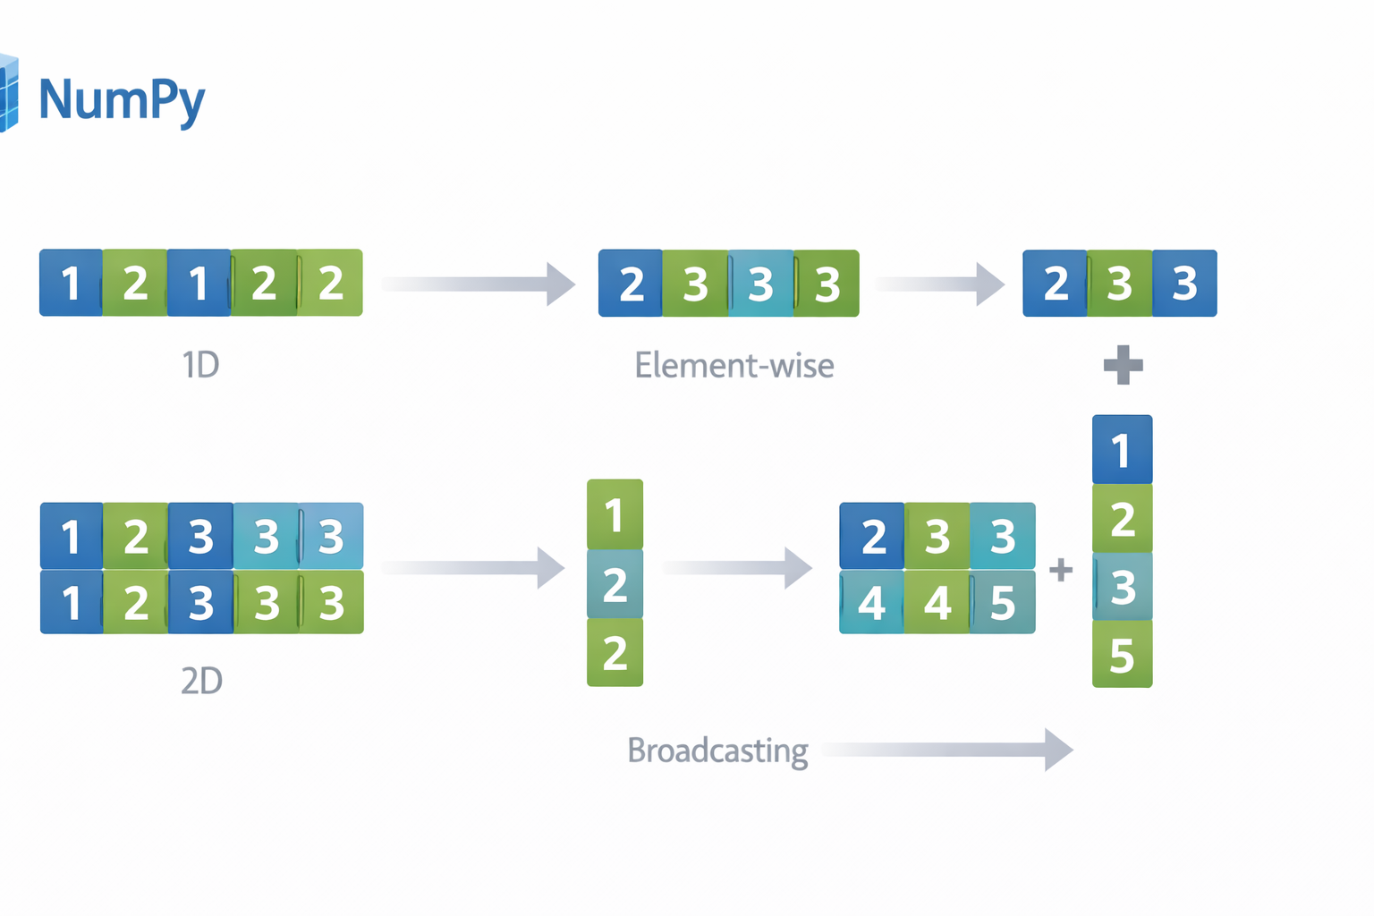

Slide 5
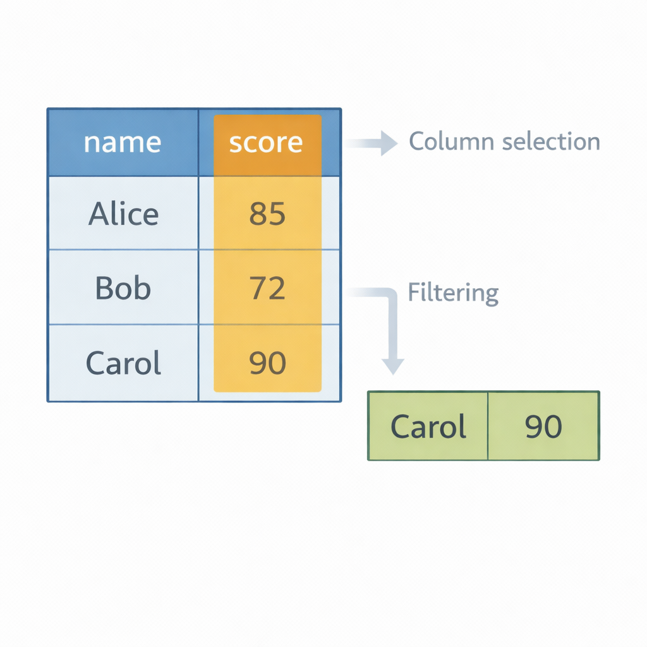
Pandas Series & DataFrames
Pandas structures data into labeled Series and DataFrames for analysis.
Series = 1D labeled data
DataFrame = 2D tabular data structure
Built on top of NumPy
Supports indexing, filtering, slicing
Ideal for structured datasets (CSV, Excel, SQL)
Notes:
Explain how Pandas adds labels on top of NumPy arrays, making data analysis intuitive and readable.

Slide 6
Code Example
import pandas as pd
data = {
"name": ["Aina", "Ali", "Mira"],
"score": [85, 70, 92]
}
df = pd.DataFrame(data)
print(df["score"].mean())

Slide 7
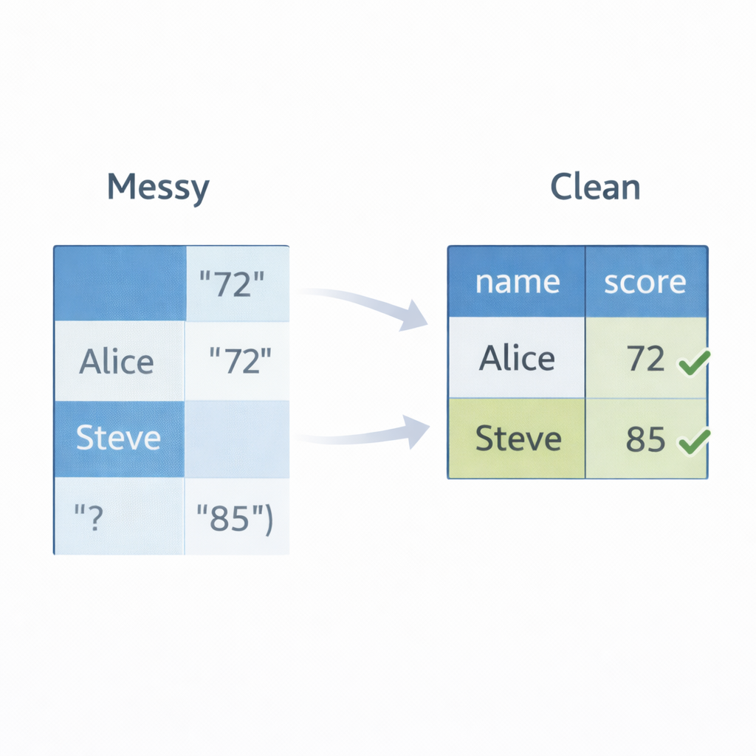
Data Cleaning
Data cleaning prepares raw data for reliable analysis.
Handle missing values (isna(), fillna())
Remove duplicates
Type conversion (astype())
Rename columns
Filter invalid rows
Notes:
Stress that real-world data is rarely clean. Cleaning is often 70% of data work.

Slide 8
Code Example
df["score"] = df["score"].fillna(0)
df = df.drop_duplicates()
df["score"] = df["score"].astype(int)

Slide 9
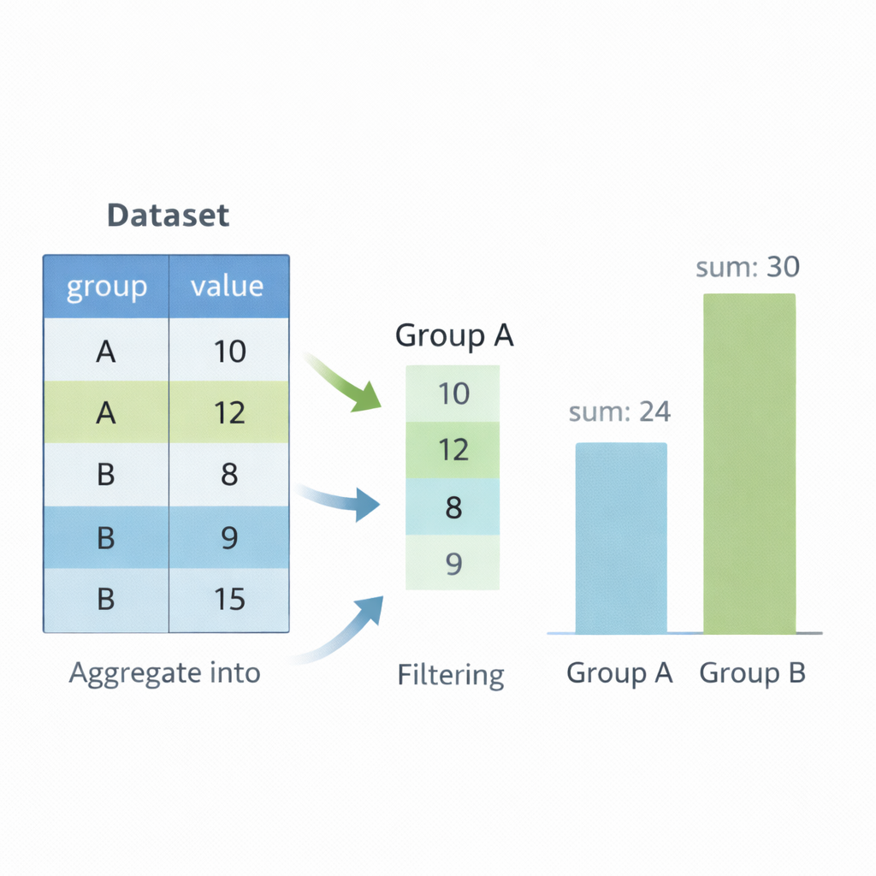
Grouping & Aggregation
Grouping allows summarizing data across categories.
groupby() splits data into groups
Apply aggregation: mean, sum, count
Enables business insights
Supports multiple aggregations
Essential for reporting & analytics
Image Prompt
Speaker Notes
Notes:
Explain “split–apply–combine” model. Show how grouping transforms raw data into insights.

Slide 10
Code Example
df = pd.DataFrame({
"class": ["A", "A", "B", "B"],
"score": [80, 90, 70, 85]
})
grouped = df.groupby("class")["score"].mean()
print(grouped)

Slide 11
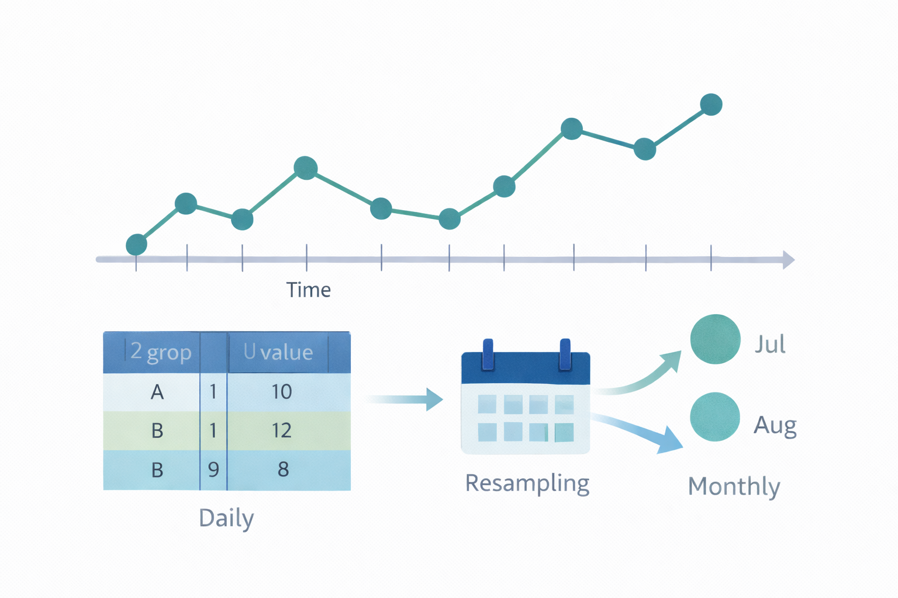
Time Series
Time series analysis handles data indexed by dates and time.
Use datetime indexing
Resampling (daily → monthly)
Rolling windows (moving average)
Trend detection
Widely used in finance & forecasting
Notes:
Highlight real-world use cases: financial markets, IoT data, analytics dashboards.

Slide 12
Code Example
df["date"] = pd.to_datetime(df["date"])
df.set_index("date", inplace=True)
monthly = df.resample("M").mean()
print(monthly)

Slide 13
Matplotlib Basics (Quick Charts)
Matplotlib turns your NumPy/Pandas results into clear charts for reporting.
Key Points
plt.plot() for line charts, plt.bar() for bar charts
Always add title + axis labels for readability
plt.tight_layout() prevents labels from being cut off
plt.savefig() exports charts for reports
Works directly with Pandas Series/DataFrames
Notes:
Explain that charts make summaries understandable at a glance—especially for stakeholders. Mention savefig() is important for automation/report pipelines.

Slide 14
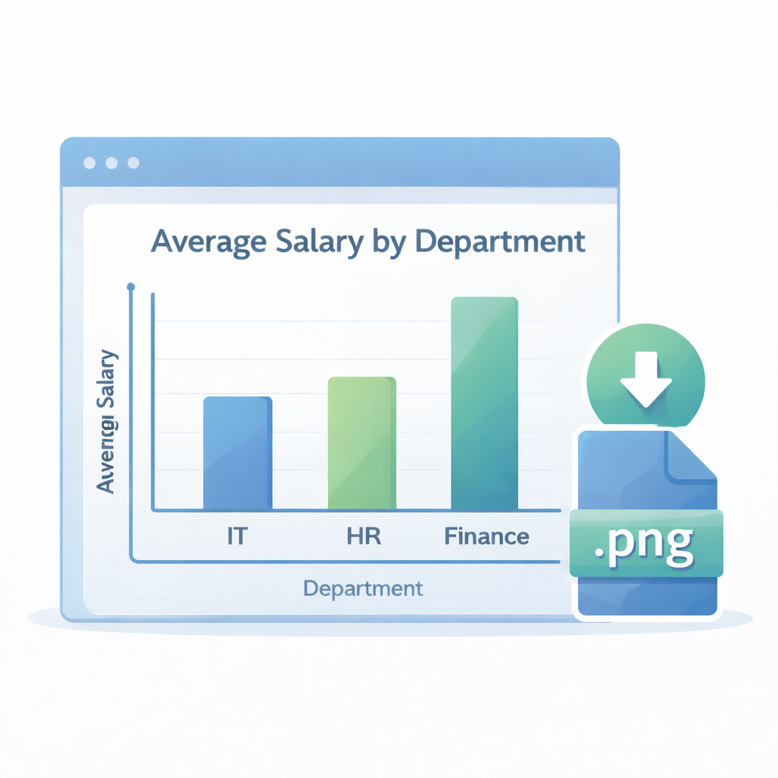
Code Example
import matplotlib.pyplot as plt
import pandas as pd
dept_avg = pd.Series({"IT": 5200, "HR": 4300, "Finance": 6000})
dept_avg.plot(kind="bar")
plt.title("Average Salary by Department")
plt.xlabel("Department")
plt.ylabel("Average Salary")
plt.tight_layout()
plt.savefig("avg_salary.png")
plt.show()

Slide 15
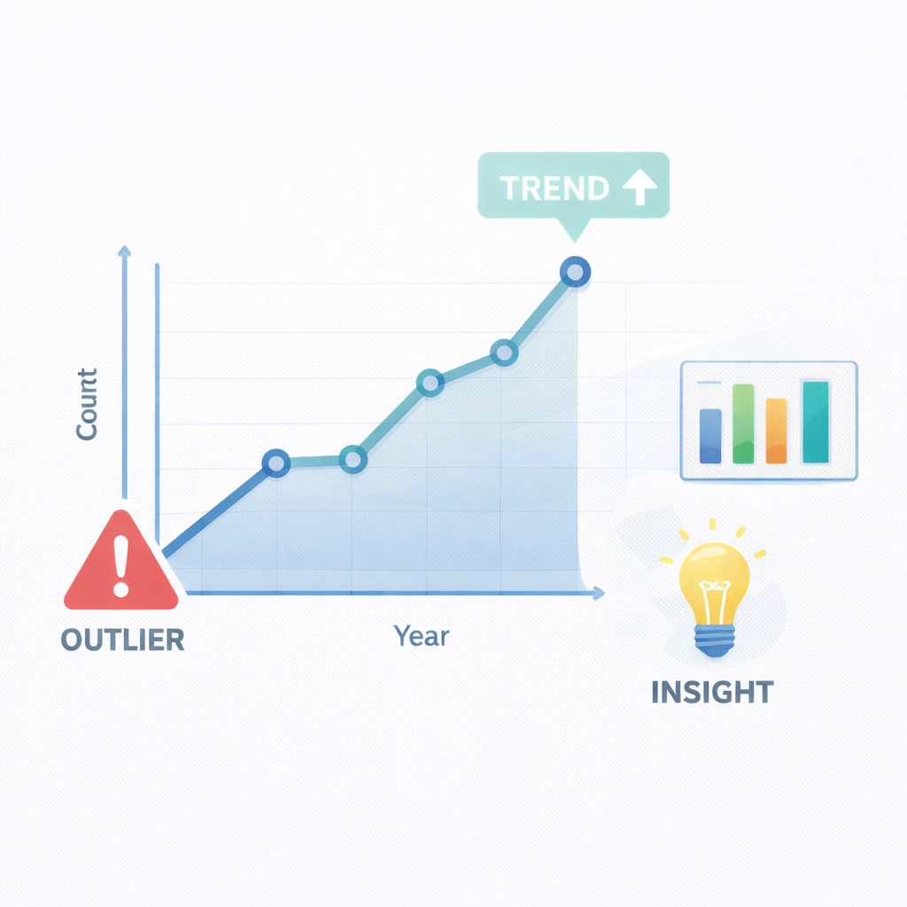
Data Visualization for Insights (Trends & Comparisons)
Use charts to compare groups, spot trends, and validate your data cleaning decisions.
Bar charts: compare categories (department, class, group)
Line charts: show trends over time (time series)
Histograms: see distributions (salary spread, scores)
Visuals help detect outliers and weird data quickly
Combine with aggregations (groupby/resample) for reporting
Notes:
Point out: visualization is a “sanity check” after cleaning. If the chart looks suspicious, the data may still be messy (wrong types, missing values, duplicates).

Slide 16
Code Example
import matplotlib.pyplot as plt
import pandas as pd
df = pd.DataFrame({
"hire_date": ["2022-01-10", "2021-05-20", "2023-03-15", "2020-07-01"],
"salary": [5000, 4000, 5500, 6000]
})

Slide 17
Code Example (2)
df["hire_date"] = pd.to_datetime(df["hire_date"])
df["hire_year"] = df["hire_date"].dt.year
counts = df.groupby("hire_year")["salary"].count()
counts.plot(kind="line", marker="o")
plt.title("Employees Hired per Year")
plt.xlabel("Year")
plt.ylabel("Count")
plt.tight_layout()
plt.show()

